Slide 1
Certificação de Segurança Ferroviária
Elise Grossemy – Sales Manager
elise.grossemy@certifer.eu

Slide 2
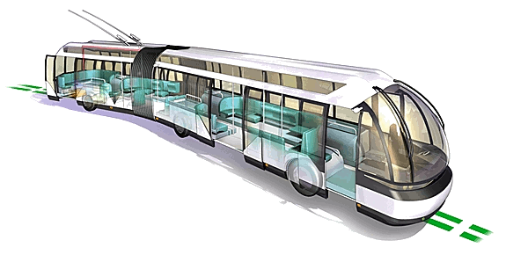
T é l : + 3 3 ( 0 ) 3 2 7 2 8 3 5 0 0
www.certifer.eu
Siège social: 1, place de Boussu
B.P. 70141 - F59416 ANZIN Cedex
CERTIFER SA - TVA/SIRET: FR28 802 053 397/00021 - Code NAF: 7120B

Slide 3
Presentation Outline
Introduction

Slide 4
1997
1998
2009
Nov. 2013
Jan. 2013
Jan. 2012

Slide 5
Introduction
Certifer is a company existing since 1997 and located in the north of France.
Today, Certifer is a company with subsidiaries:
In Algeria
In Italy (performing mission according the italian regulation )
with Trames Urbaines(subsidiary completely dedicated to the integration of the LRT in their environment)

Slide 6
Presentation Outline
What is a railway transport system?

Slide 7
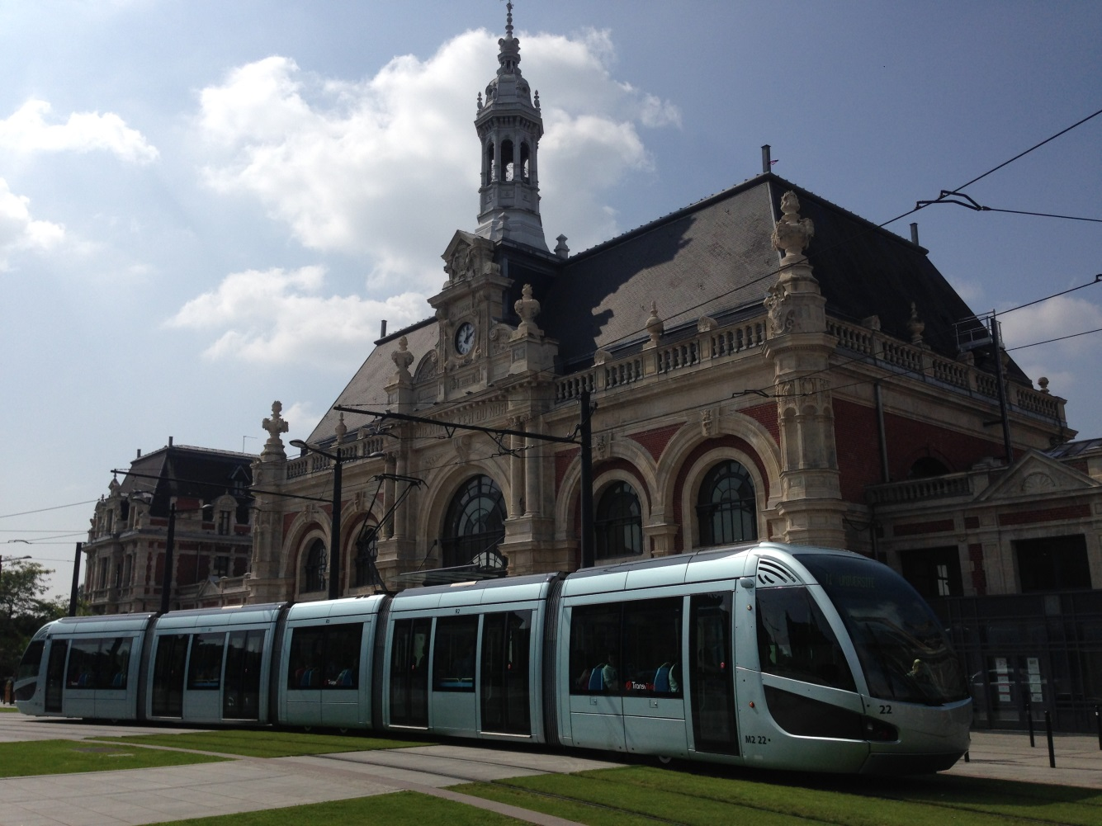
In nominal conditions

Slide 8
A railway system transport includes:
Infrastructures (track, bridges, civil engineering,…)
Technical safety facilities (track side signalling, soft…)
rolling stock (bogie, brake, …)
operation and maintenance principles and rules
All the interfaces between sub-systems (CBTC programming is directly concerned with operation rules)

Slide 9
Bruxelles – Mons – Quiévrain
In degraded situations

Slide 10
Brétigny

Slide 11
Presentation Outline
Why certify a system?

Slide 12
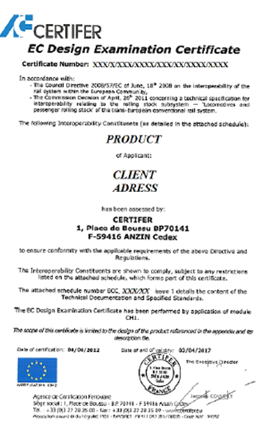
The Certification is a process performed by a third part body.(guarantee of the independance and impartiality of a body)
This guarantee is possible thanks to the accreditation delivered by accreditation commitee

Slide 13
The certification procedure aims at ensuring that a railway product/ subsystem or full system comply with requirements of a framework (standards, regulation,…)

Slide 14
The key role of the Independent Safety Assessor as a second view:
2 additionnal misions
The compliance certificate to the rules, standards and state of art.
The assessment ot the achievement of the safety level
An independence requested for each project

Slide 15
Presentation Outline
What type of certification?

Slide 16
In railway field, the well-known certification is performed according Cenelec standards (EN50126, 50128, 50129)
This certification follows the V cycle of the project (from the definition to the commissioning)

Slide 17
Presentation Outline
What bring a certification?

Slide 18
Certification allows:
To ensure that the system is developed in a safe and secure way;
To ensure that the system meets the safety requirements for its use and during its life cycle.
System certification to this standards provides international recognition to the national railway authorities and railway operators;
It provides added confidence to the consumers

Slide 19
give the confidence on the safety of the global system,
regarding banks, insurance and National Safety Authority requests is more and more considered as a mandatory work
With a small cost regarding the global price of the project…

Slide 20
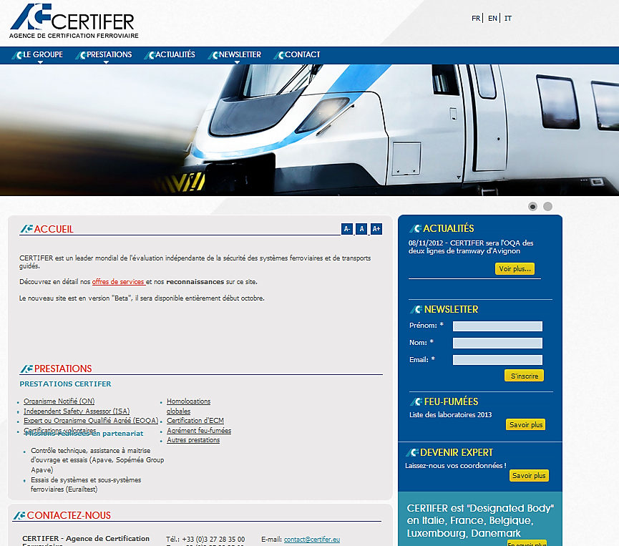
To know more about us: www.certifer.eu

Slide 21
Elise GROSSEMY – Sales Manager
Aryldo G RUSSO JR- General Manager for Latin America
Aryldo.russo@certifer.eu
Obrigado pela atenção !
Merci pour votre attention !
Thank you for your attention !

